Slide 1
Friday Playback
October 14th 2022
Akula Sai Bala Siva Jyothika

Slide 2
Current Learning Progress
As of October 13th 2022
Progress by course
Per Original Schedule
Per Updated Schedule
Target For October 17th
AWS
Java training in internship
Unix
Devops Certificate
Azure
Python
Completed
completed
Completed
On Schedule
Completed
Completed
Completed
completed
Completed
On Schedule
Completed
Completed
Completed
completed
Completed
On Schedule
Completed
Completed

Slide 3



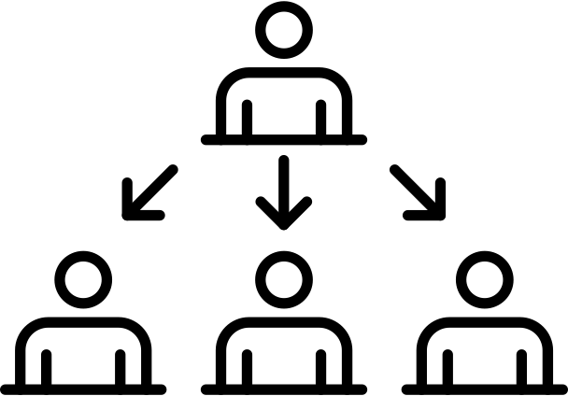
What Could Have Been Done Better
Constructive Feedback
Detailed Feedback:
During internship I completed Java trainings.​
I am currently working on DevOps basic trainings .
Technical Red Tape:
Not faced any issue till now
Setting Expectations:
Expecting training sessions and handson experience.
Organizational Clarity:
Most of the expectations were met.

Slide 4
What Has Been Done Well
Positive Feedback
Learning Material:
1) Percipio Courses are good​
2) refered related topics from other sources
The Mentors:
Mentor assigned us courses and we are currently working on it.
Leader Sessions:
No leader sessions till now.
Team Communication:
We communicated with mentor and updating the status.

